Slide 1
Cineplex – Case Analysis
801: Intro to Management
Team Gordon
May 7, 2024

Slide 2
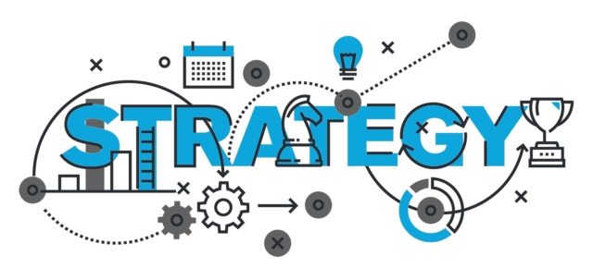
PART A - Strategy
(1) Purpose: Identify industry trend and market window, determine the gap and industry. Figure out what makes the company stays competitive.
Strategy positioning attempts to achieve constant competitive advantage over rivals by preserving distinctiveness and uniqueness of the company.
Key components:
Where, Why, How to Compete and Win
Competitive Advantage (SCA) Recognition
Trade off Acknowledgement
Business Model Assessment
Notes:
It means to perform different activities from rivals or similar activities in different ways.
•Understands market direction, shaping, collision, and conflict, Customer and rival behaviour prediction
•VRIN/VRIO…what we do is valuable, rare, inimitable, and non-substitutable, Understands advantage, leverage, and sustainability of the SCA
Strategy requires you to make trade-offs in competing—to choose what not to do.

Slide 3
6 elements
Vision & Purpose Clarity
Market Mapping (Shaping)
Best of Breed & Disruptive Rival Analysis
Competitive Position – Advantage, Parity, Disadvantage
Market Profitability & Attractiveness Analysis
Business Model Assessment

Slide 4
PART A – Elements in Analytical Process
Competitive Position – Advantage, Parity, Disadvantage
Vision & Purpose Clarity
Market Mapping (Shapping)
Analytical Process
Market Profitability & Attractiveness Analysis
Best of Breed & Disruptive Rival Analysis
Business Model Assessment
Notes:
(2) Vision & Purpose Clarity – To stay competive wtihin the market amongst the OTTs
Market Mapping (Shapping) - downward sloping customer demand with the booming of OTTs, covid accelerated the downward slope
Best of Breed & Dispruptive Rival Analysis – tried competting with the OTTs by introducing Cineplex (streaming).
Competitive Position /disadvantages– monolopy, locations are in high-traffic areas/accessible, dependent movies that are available,

Slide 5
PART A – Outcomes to achieve
Create/define values
Delivery Blueprints
Magnitude & Speed Conclusion
Strategic Plans
Notes:
Create/define values – Focus on the core values of the company
Defining organizational values helps establish a shared understanding of the desired culture and shapes how employees interact with each other, customers, and stakeholders.
Delivery Blueprints - provide a structured framework for executing tasks efficiently and effectively to achieve objectives.
Magnitude & Speed Conclusion
In strategic planning, it's essential to consider both the magnitude, or size, of the impact that a particular initiative or decision will have, as well as the speed at which it can be implemented. Like how long does it takes in the pace of situation to take actions
Strategic Plans
Strategic plans are comprehensive documents that outline an organization's long-term goals, objectives, strategies, and action plans to achieve its vision and mission.

Slide 6
Part B – Situation Analysis
Strengths | Weaknesses
Offers in-person movie experience, Access to the latest movies | Lack of competitive pricing (compared to OTTs) Reliance on film industry to drive demand Lack of up-to date technology
Opportunities | Threats
Increase in-person experience through new customer experience opportunities (i.e. old movies/musicals, concerts, sports, private viewing, talk shows/events) | Declining market demand due to change in customer behaviour (i.e. shorter attention spans) OTTs Short-form Video Platforms(SVPs)
Notes:
Despite having 75% market share, attendance was significantly declining pre-covid, and with covid this accelerate the drop in demand.

Slide 7
Part B – Complication
Problem:
Unable to capture market demand against competitors, with heavy reliance on the film industry and inability to adapt to new technology/platforms (cost).
Lack innovations on the service offerings.
Changed consumer habits due to the prevalence of OTT platforms and short-form video platforms.
Large disparities in terms of hardware. Most of the locations have the same and worn-off hardware for decades.
Poor customer experience with booking apps and Cineplex's own OTT platform.
Very traditional, limited and antiquated marketing and advertising strategies which is also very costly have compelled many movie producers to cooperate with OTT platforms.

Slide 8
6. Questions to Managment:
How can Cineplex leverage AI/data to enhance cinema experience?
What strategies can Cineplex take to enhance their market position and less reliability on the film industry?
How did the customer behaviour change in the pandemic and with the introduction of OTTs?
Any potential mergers and acquisitions planned to improve their competitive position in the market?
More data on the cost per movie. So, we have better knowledge on the price competitiveness with OTTs.

Slide 9
Recommendations
Option 1 – Target expanding the customer base (new and existing) through innovating existing customer experience through upgrading technology and new service offerings (leverage AI Analytics from CinePoints)
Option 2 – Tap into new customers through partnerships with other experience companies (i.e. sporting events, concerts).
Option 3 – Increase profit margin by streamlining their department focus, prioritizing on the core operations (i.e. in-person) and dropping unprofitable segments, reduce operational costs (i.e. OTTs)
Notes:
Option 1 – targeting grow the customer base (through experience, access), analysis spending for
Option 2 – targeting new customers (through partnerships), understanding customer needs through cinepoints analysis
Option 3 – targeting margin growth (though cinepoints analysis)

